Slide 1
Analyzing Recursive Algorithms
5.2

Slide 2
Analyzing Recursive Factorials
We have seen four different recursive algorithms
We can get a feeling for recursive performance from the recursion trace
What's important to count is the number of method calls, activations
How that number grows with depth and width of calls

Slide 3
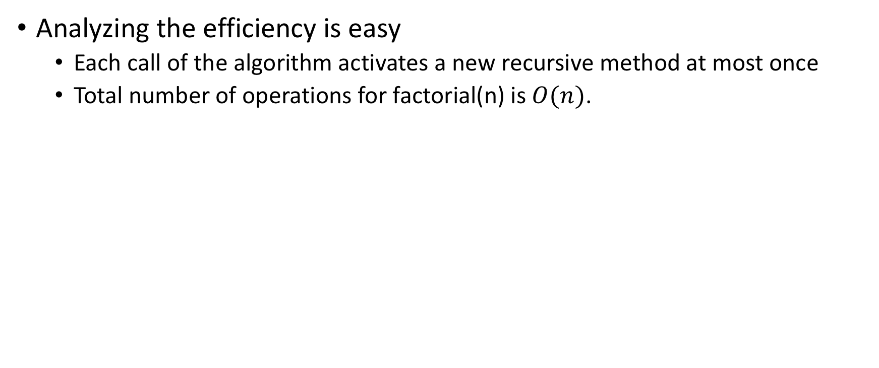
Computing Factorials
Analyzing the efficiency is easy
Each call of the algorithm activates a new recursive method at most once
Total number of operations for factorial(n) is $O(n)$.
ffactorial(n)
calls
returns value
ffactorial(n-1)

Slide 4
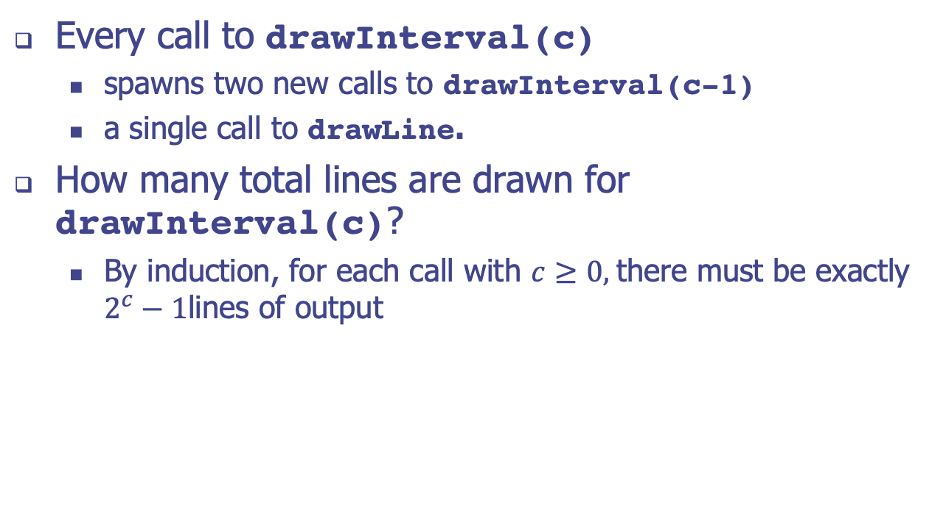
Drawing an English Ruler
Every call to drawInterval(c)
spawns two new calls to drawInterval(c-1)
a single call to drawLine.
How many total lines are drawn for drawInterval(c)?
By induction, for each call with $c≥0,$there must be exactly $2^{c}−1$lines of output
c | lines
0 | 0
1 | 1
2 | 3
3 | 7

Slide 5
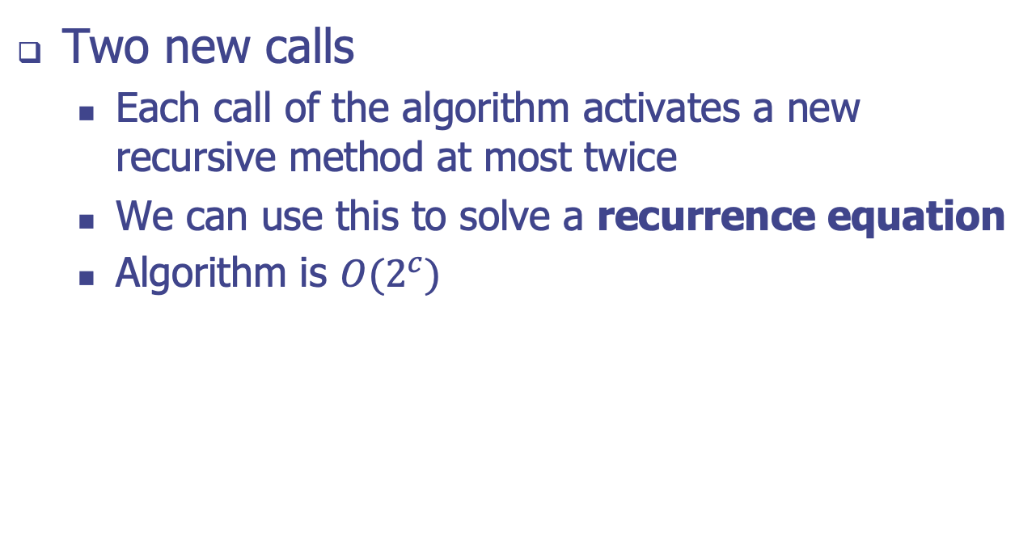
English Ruler
Two new calls
Each call of the algorithm activates a new recursive method at most twice
We can use this to solve a recurrence equation
Algorithm is $O(2^{c})$
fdrawInterval(c)
calls
calls
drawInterval(c-1)
drawInterval(c-1)

Slide 6
Performing a Binary Search
Proposition 5.2: The binary search algorithm runs in O(log n) time for a sorted array with n elements.
The number of elements remaining to be searched is always high − low + 1
The number of remaining elements to be searched is reduced by half each step, either:

Slide 7
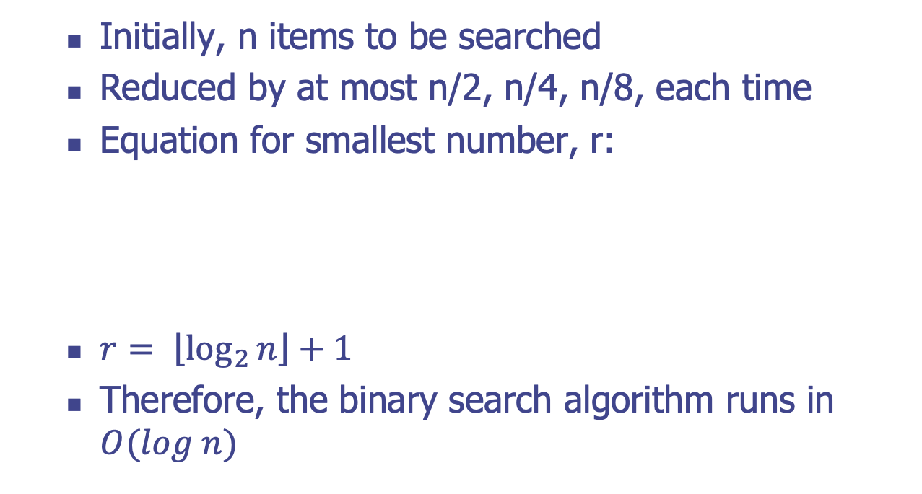
Performing a Binary Search
Initially, n items to be searched
Reduced by at most n/2, n/4, n/8, each time
Equation for smallest number, r:
$r= \left\lfloor \left.\log_{2}{n}\right\rfloor \right.+1$
Therefore, the binary search algorithm runs in $O(log n)$

Slide 8
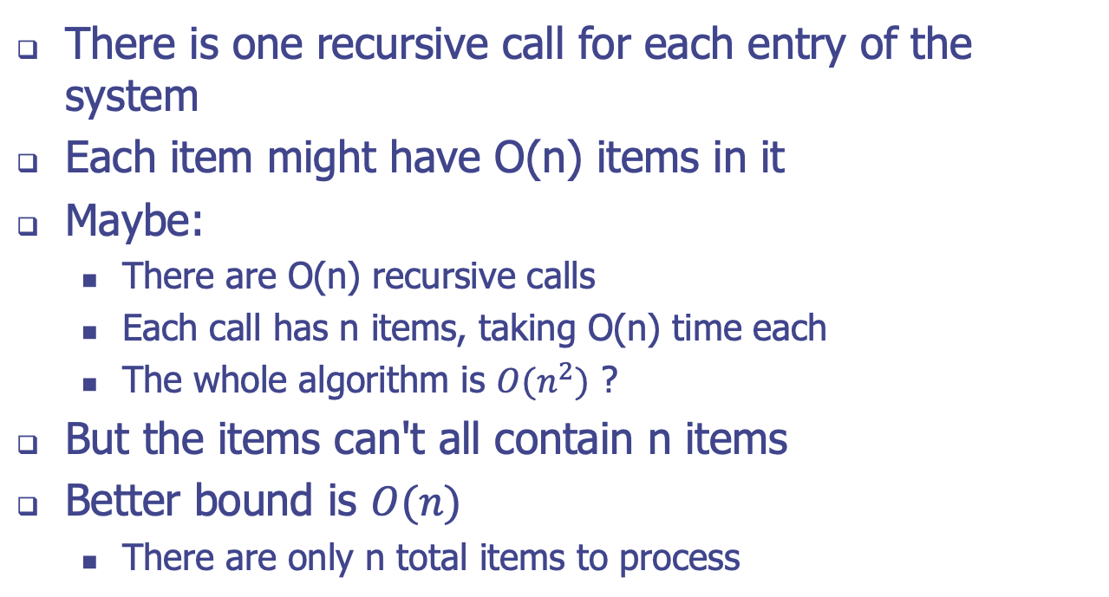
Computing Disk Size
There is one recursive call for each entry of the system
Each item might have O(n) items in it
Maybe:
There are O(n) recursive calls
Each call has n items, taking O(n) time each
The whole algorithm is $O(n^{2})$ ?
But the items can't all contain n items
Better bound is $O(n)$
There are only n total items to process

